Slide 1
Recipe Buddy
By: Alex Dering, Peter Russell, Matthew Bell, and Dana Greene
Notes:
Dana Greene

Slide 2
Overview
Recipe Buddy will be a web based app where users can create and share recipes with other users. Users can specify the ingredients and utensils they have in their kitchen. This will allow users to search for recipes that they can make. Users can rate and comment on recipes which will influence how the recipes appear when searched.
Notes:
Dana Greene

Slide 3
Functional Requirements
Create Account
Login/Logout
Create/Edit/Delete recipes
Search/Filter recipes
Share recipes with other users
Rate and comment on other recipes
Notes:
Peter Russell

Slide 4
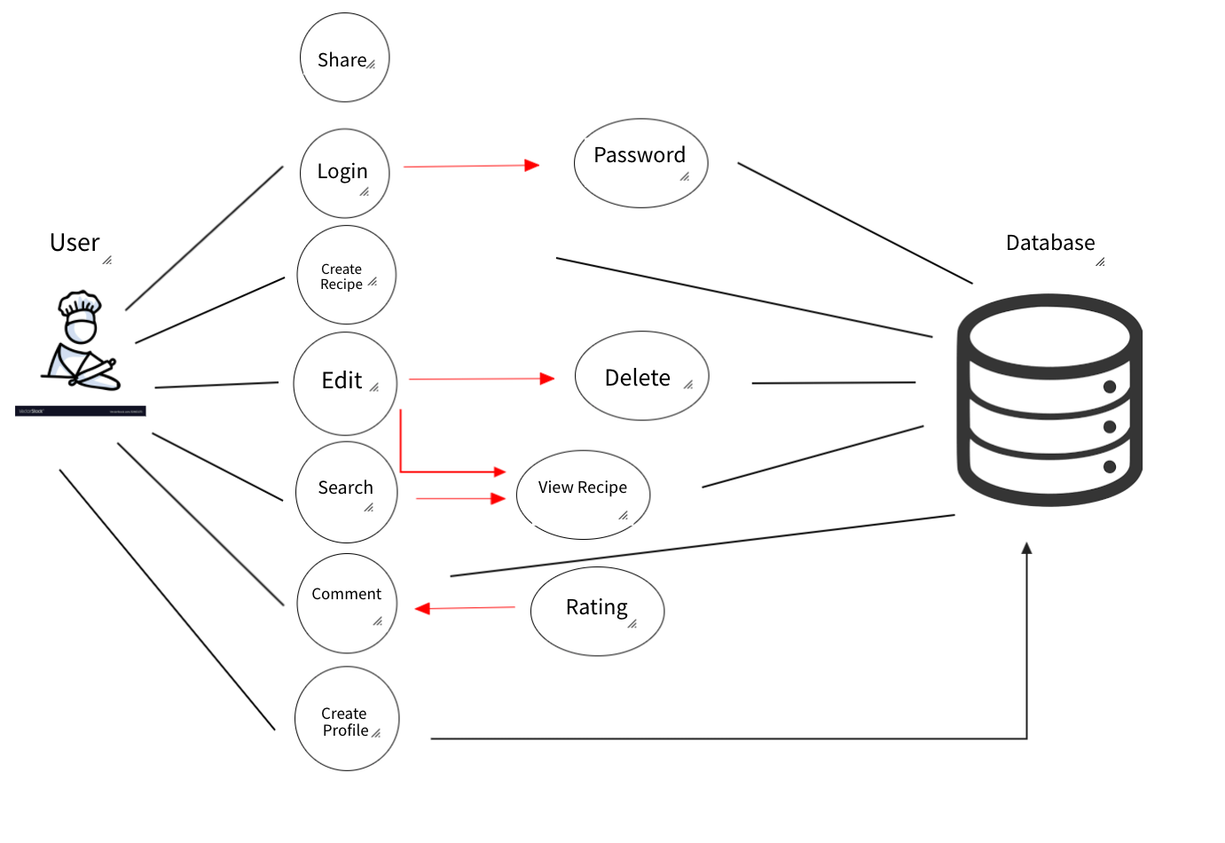
Notes:
Peter Russell

Slide 5
Time frame for requirements
Requirement | Priority(1-5) | Criticality(1-5) | Volatility(1-5) | Time | Developers
Create an account | 5 | 5 | 2 | 2 weeks | 2
Login/Logout | 5 | 5 | 1 | 1 week | 1
Create/Edit/Delete recipes | 5 | 5 | 3 | 2 weeks | 2
Search/filter recipes | 4 | 5 | 4 | 2 weeks | 2
Share recipes | 1 | 1 | 2 | 1 week | 1
Rate and comment on recipes | 2 | 2 | 2 | 1 week | 1
Notes:
Alex Dering
Minimum viable product:

Slide 6
Non-Functional Requirements
Consistent design
Easy to use
Display recipes on homepage
Minimal empty space
Security
Notes:
Alex Dering

Slide 7
Interface
Home page
Create account interface (as well as pantry)
Searching interface
Creating a recipe
Viewing your own recipes
Notes:
Matt Bell

Slide 8
Home
Login
Create Account
My profile
Logout
Name/Logo
Search
Recipe 1
Recipe 2
Recipe 3
Time to make
Ingredient 1
Ingredient 2
Ingredient 3
etc.
Time to make
Ingredient 1
Ingredient 2
Ingredient 3
etc.
Time to make
Ingredient 1
Ingredient 2
Ingredient 3
etc.
Notes:
Matt

Slide 9
Home
List Ingredients:
+
Name
Username:
List Utensils:
Password:
+
Verify Password:
Create
Notes:
Matt

Slide 10
Home
Username:
Password:
Login
Notes:
Matt

Slide 11
Home
My profile
Logout
Username
My Recipes
My Pantry
Time to cook
Ingredient 1
Ingredient 2
Ingredient 3
Time to cook
Ingredient 1
Ingredient 2
Ingredient 3
Recipe 1
Recipe 2
Utensils
Utensil 1
Utensil 2
Utensil 3
View all>>
Rating Comments
Rating Comments
Share Edit
Share Edit
Ingredients
Ingredient 1
Ingredient 2
Ingredient 3
View all>>
Time to cook
Ingredient 1
Ingredient 2
Ingredient 3
Time to cook
Ingredient 1
Ingredient 2
Ingredient 3
Recipe 3
Recipe 4
Rating Comments
Rating Comments
Create New Recipe
Share Edit
More>>
Share Edit
Notes:
Matt

Slide 12
Home
Search
My profile
Logout
Time to cook
Ingredient 1
Ingredient 2
Ingredient 3
Time to cook
Ingredient 1
Ingredient 2
Ingredient 3
Time to cook
Ingredient 1
Ingredient 2
Ingredient 3
Time to cook
Ingredient 1
Ingredient 2
Ingredient 3
Recipe 1
Recipe 2
Recipe 3
Recipe 4
Rating Comments
Rating Comments
Rating Comments
Rating Comments
Time to cook
Ingredient 1
Ingredient 2
Ingredient 3
Time to cook
Ingredient 1
Ingredient 2
Ingredient 3
Time to cook
Ingredient 1
Ingredient 2
Ingredient 3
Time to cook
Ingredient 1
Ingredient 2
Ingredient 3
Recipe 1
Recipe 2
Recipe 3
Recipe 4
Rating Comments
Rating Comments
Rating Comments
Rating Comments
<<Previous Page
Next Page>>
Notes:
Matt

Slide 13
Home
My profile
Logout
Title:
List Ingredients:
+
Step 1:
List Utensils:
Step 2:
T
+
+
Add Step
+
Add Timer Step
Create
Notes:
Matt

Slide 14
Home
My profile
Logout
Recipe Name
Cooking time: 0hr 45m
Utensils
Utensil 1
Utensil 2
Utensil 3
View all>>
Step 1: _____________________________________________________
Step 2: _____________________________________________________
Step 3: _____________________________________________________
Step 4: _____________________________________________________
Step 5: _____________________________________________________
Step 6: _____________________________________________________
Step 7: _____________________________________________________
Ingredients
Ingredient 1
Ingredient 2
Ingredient 3
View all>>
Write a comment:
Send
Notes:
Matt

Slide 15
Testing and Risks
Testing
Test cases for creating accounts and recipes
Once recipes are created sharing, liking and commenting will all be tested
Website will be prepopulated with other recipes and accounts
Risks
Accounts must be secure (password hashing)
Logout not actually logging users out
Misspelled ingredients/utensils during account creation
No way for users to recover an account
Notes:
Dana

